Slide 1

CMR ENGINEERING COLLEGE
UGC AUTONOMOUS
Department of Electronics and Communications Engineering
A Major Project Presentation on
Emotion Recognition from Text Stories Using
Emotion Embedding Model
Batch No: A1
Under the Guidance of
Dr.S.Poongodi
Professor
ECE, CMREC
Submitted by:
Peethani Nagasree (198R1A0401)
Ambala Naresh(198R1A0402)
Anand Terati (198R1A0403)
Ankita (198R1A0404)

Slide 2
CONTENTS
Motivation
Rationale
Objective
Abstract
Existing Method
Proposed Method
Block Diagram
Result
References
Department of ECE, CMR Engineering
2
College, Hyderabad

Slide 3
MOTIVATION
We analyze the emotions and sentiments of a given text or an essay using an emotion embedding model.
To accurately identify and understand the emotional content of text in order to improve human-machine interactions and to gain insights into human emotions and behavior.

Slide 4
RATIONALE
We present a method to extract the emotion of a sentence using an emotion embedding model.
Sentiment emotion analysis is used to tell whether the whole text is positive or negative.

Slide 5
OBJECTIVE
The objective of the project is to analyze emotions from story texts based on the emotional words representing each story sentence.
Extracting emotional words from a text story dataset and detecting emotions using the proposed Natural language Processing(NLP).

Slide 6
ABSTRACT
Emotion can be expressed in many ways, such as facial expressions, gestures, speech, and written text.
Emotion Detection in text documents is essentially a content-based classification problem involving concepts from the domains of Natural Language Processing as well as Machine Learning
Sentiment analysis is a natural language processing technique used to analyze the sentiment of a piece of text, whether it is positive, negative, or neutral.
They generate emotion embeddings using the model and then train a logistic regression model for emotion classification. We then evaluate the model on a test set and report the accuracy.
.

Slide 7
EXISTING METHOD
Machine learning systems: The model can predict the emotions expressed in new text based on the patterns it has learned from the training data. They require large amounts of labeled data.
Natural Language Processing is a branch of AI that has the ability to understand text and predict emotion whereas Sentiment Analysis is a core part of NLP which identifies the sentiment behind the text.
Deep learning systems: These systems use deep neural networks to learn the relationships between words and emotions in text.

Slide 8
PROPOSED METHOD
Different techniques have been used for methodology in ML for its objectives. Data collection is done in the first step of NLP.
The dataset is pre-processed by removing unwanted data. Then, the data was split into two sets: the training and testing sets using NLP which involves Sentiment Analysis.
Train data has split up from 80% to 70% whereas Test data has spilt up from 10% to 20%.
After testing data evaluation parameters are accuracy, precision, recall, and F1 score.

Slide 9
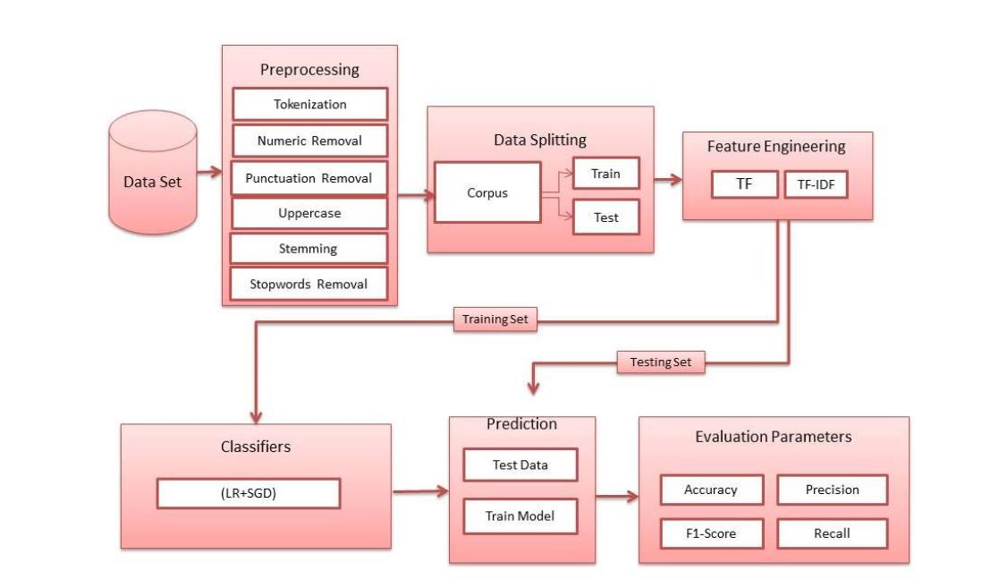
BLOCK DIAGRAM
Fig1. Block diagram of proposed system

Slide 10
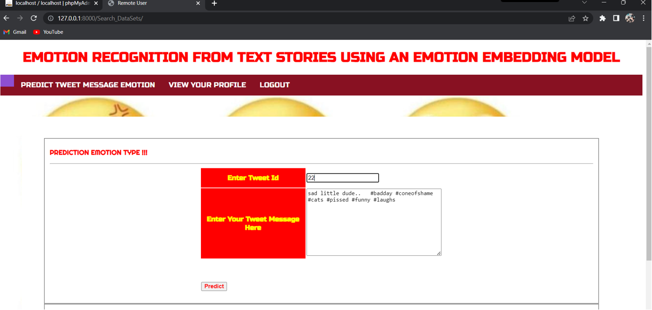

RESULT
Fig1:Input Data
Fig2:Output Data

Slide 11

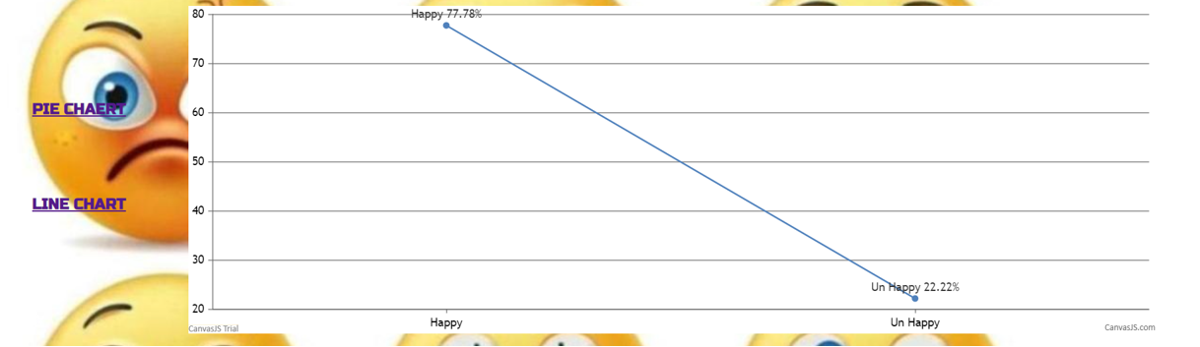
RESULT
Fig3:Final Percentage of Data
Fig4:Linegraph

Slide 12
REFERENCES
A. Seyeditabari, N. Tabari, and W. Zadrozny, “Emotion detection in text: a review,” arXiv preprint arXiv:1806.00674, 2018.
K. Pichotta and R. Mooney, “Statistical script learning with recurrent neural networks,” in Proceedings of the Workshop on Uphill Battles in Language Processing: Scaling Early Achievements to Robust Methods, 2016, pp. 11–16.
P. Bojanowski, E. Grave, A. Joulin, and T. Mikolov, “Enriching word vectors with subword information,” Transactions of the Association for Computational Linguistics, vol. 5, pp. 135–146, 2017.

Slide 13
THANK YOU !
27/6/2022
Department of ECE, CMR Engineering College, Hyderabad
13

